Slide 1


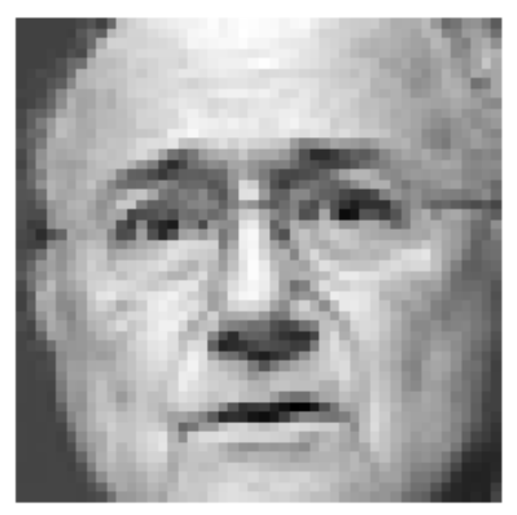

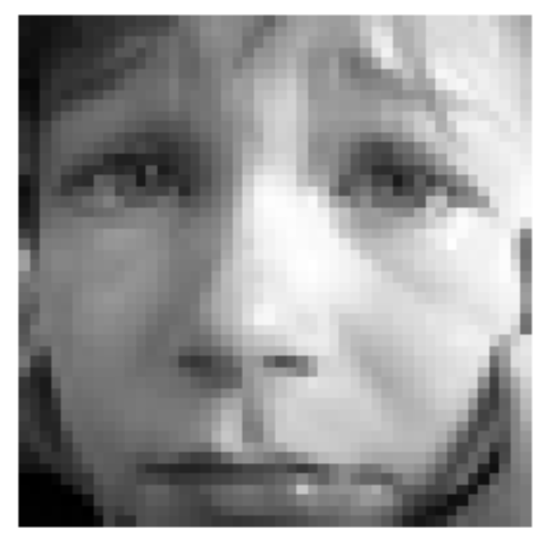

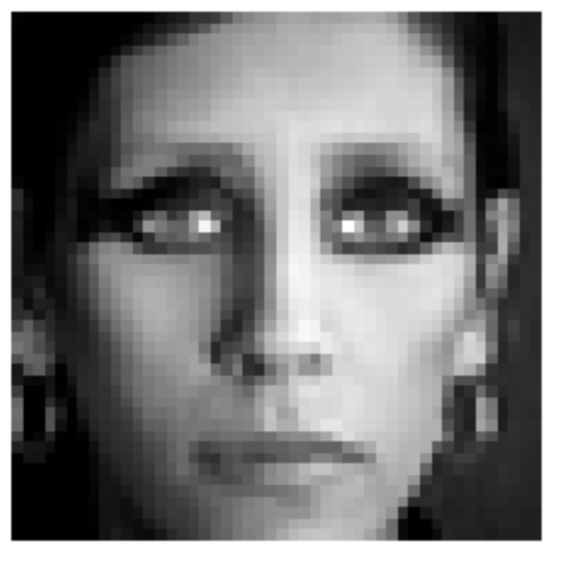
Facial IMAGE RECOGNITION
Classes: 0=Angry, 1=Disgust, 2=Fear, 3=Happy, 4=Sad, 5=Surprise, 6=Neutral
Team bengio:
Akshay Agarwal kannu priya arora vinod elangovan Gaurav FNU
Pankaj mittal claude phan Sandeep Kataria

Slide 2
Data source: https://www.kaggle.com/c/challenges-in-representation-learning-facial-expression-recognition-challenge/data
Training data size
***elaborate count info
Methodology:
Linear Classification Analysis
Logistic Regression Analysis
Principal Component Analysis
Neural Networks

Slide 3
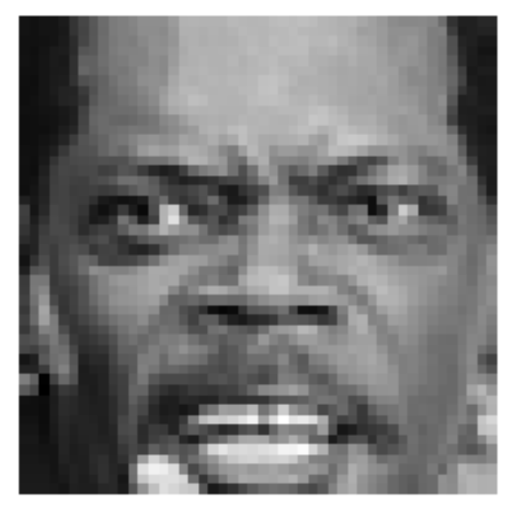
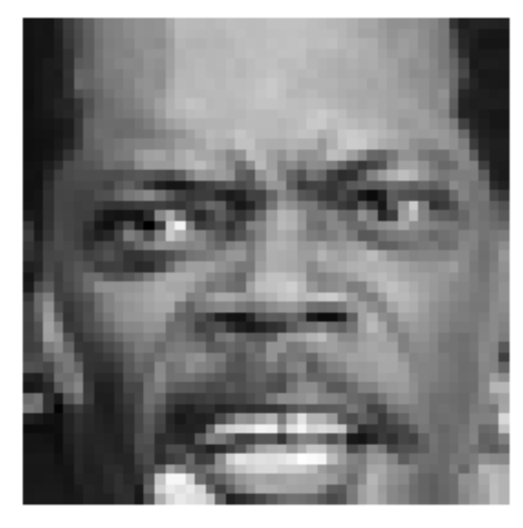
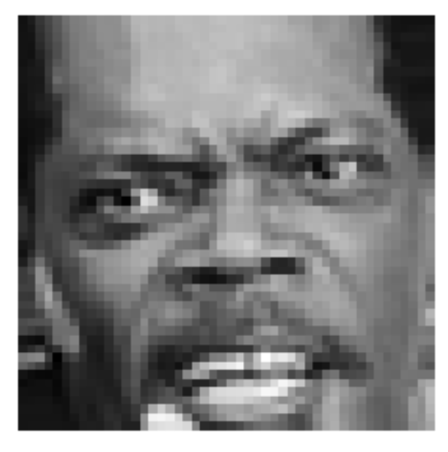
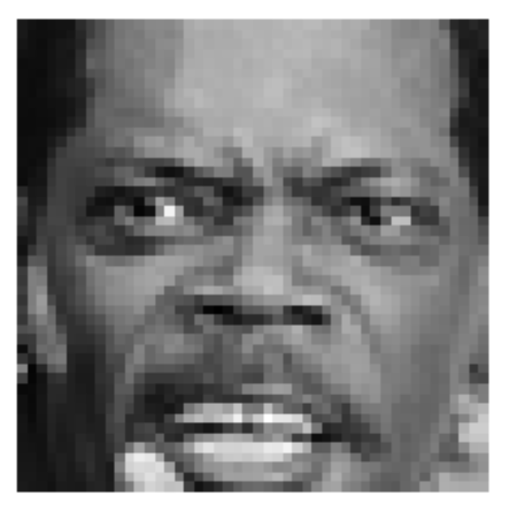
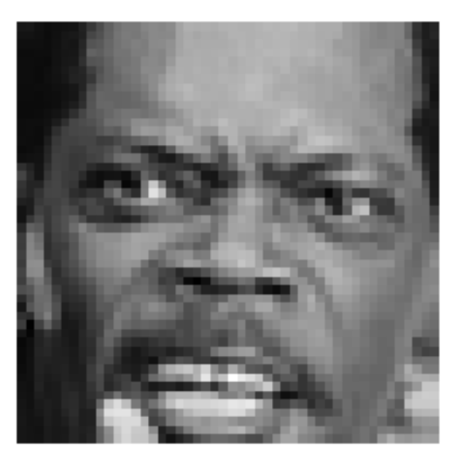
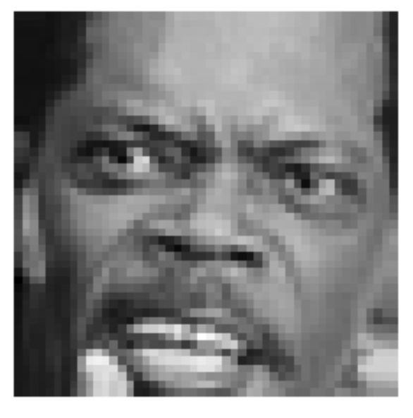

Data Augmentation: Data Size Increase using Image Rotation
3 degrees
6 degrees
10 degrees
Left
Right

Slide 4
K-means, Cluster purity & Expectation Maximization

Slide 5
Logistic Regression classifier

Slide 6
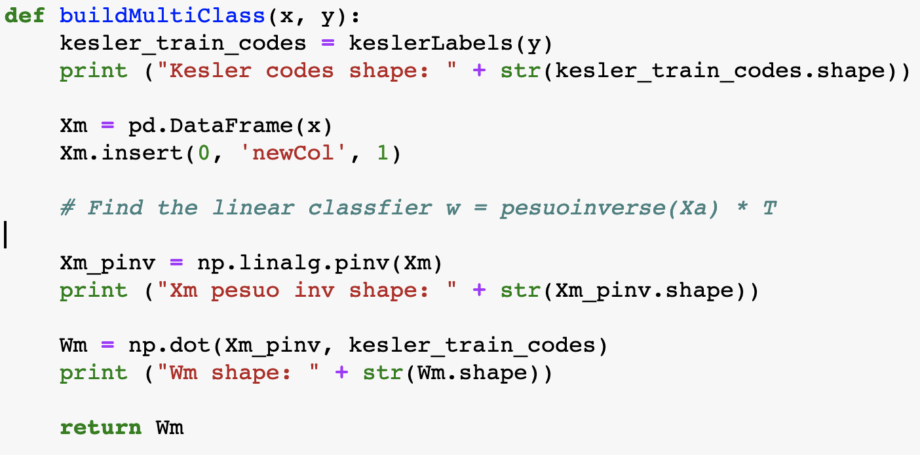
linear classifier
42% Accuracy on Test Data
37% Accuracy on Training Data
Using original dataset + 6 degree + 10 degree rotations
Attempted to use PCA, yet accuracy was much worse

Slide 7
Bayesian Classifier

Slide 8
Neural Network

Slide 9
Model performance - Summary
 | Training Set Accuracy | Test Set Accuracy | With PCA - Test Accuracy | With Data Augmentation – Test Accuracy
Linear Classification Analysis
Bayesian Classifier
Logistic Regression Analysis
Neural Network

Slide 10
Interesting Observations
Why histogram classifier did not work?

